Slide 1

Mickey Gousset
@mickey_gousset
Feature Flags for Better DevOps
Notes:
Hi everyone, and welcome to “Feature Flags for Better DevOps”! Hopefully you are at right session.
I’ve put my twitter handle in the upper right (“@mickey_gousset”). Please feel free to tweet out, tag me, and tell everyone else at the conference what they are missing!
Also, if you’ll hold questions till the end, I would appreciate it. I want the questions, so write them down so you don’t forget them. Or tweet them at me and I’ll answer them after the talk.
**CLICK**

Slide 2


Notes:
A quick shout-out and thank you to all our sponsors! They are truly what allows us to get together like this every year!
**CLICK**

Slide 3





Introducing Azure DevOps
Azure Boards
Azure Pipelines
Azure Repos
Deliver value to your users faster using proven agile tools to plan, track, and discuss work across your teams.
Build, test, and deploy with CI/CD that works with any language, platform, and cloud. Connect to GitHub or any other Git provider and deploy continuously.
Get unlimited, cloud-hosted private Git repos and collaborate to build better code with pull requests and advanced file management.
➔
Azure Test Plans
Azure Artifacts
Test and ship with confidence using manual and exploratory testing tools.
Create, host, and share packages with your team, and add artifacts to your CI/CD pipelines with a single click.
https://azure.com/devops
Notes:
I’m a Microsoft DevOps Architect on the DevOps Customer Advisory Team at Microsoft. My team’s mission is to go out and help our top customers get more “devops-y”. My team is also a part of the larger Azure DevOps team at Microsoft, which is our set of services to provide everything a developer needs to create good quality applications
**CLICK**

Slide 4


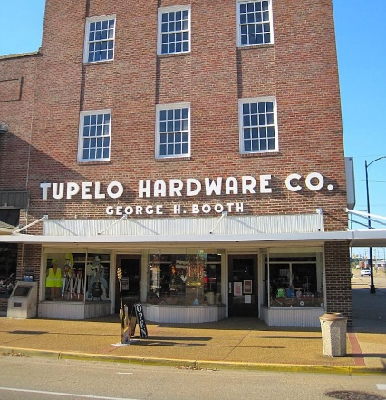
What is Tupelo, MS world-famous for?
Notes:
But first, and most importantly, I am from Tupelo, MS. Does anyone know what Tupelo, MS is world-famous for?
We are a small 35K town in north-east MS, and we get about 10K+ people a year that come to my small town, many from Europe.
**CLICK**
We are the birth-place of Elvis Presley.

Slide 5
Agenda
Level-Set: What Are Feature Flags
Feature Flag Frameworks
LaunchDarkly FFaaS
Wrap-Up
Notes:
Here is the agenda for today’s talk
**CLICK**
First, we will perform some level-settings, so we are all on the same page.
What are feature flags
Why do we care
The different types of feature flags
**CLICK**
Next, we will discuss feature flag frameworks, which are implementations of feature flags that you can start using right now. Some are free, some have a cost, and each of them implements feature flags slightly differently.
**CLICK**
In this section, we are going to look at a preview framework from the Microsoft Azure team, called Azure App Configuration, that can be used for both app configuration management, as well as feature flag management.
Then we will start talking about Feature Flag as a Service. One of the biggest players in this space right now is LaunchDarkly. We will take a spin through their tool and see how their implementation of Feature Flags holds up.
**CLICK**
Finally, we will wrap up with a look at the dark side of feature flags, some things to be aware of, and some general session conclusions.
Sound good? Allright, let’s go!
**CLICK**

Slide 6

High-performing teams continue to achieve both faster throughput and better stability.
Notes:
Every year for the past several years DORA, the DevOps Research and Assessment team, as released their State of DevOps report.
One of the findings in this report is that “High Performing teams continue to achieve both faster throughput and better stability”.
This means that teams that are in the DevOps zone, and achieving at a high level, are:
Deploying code faster, usually multiple times a day
Deploying more stable code
Able to resolve instability issues faster than teams that are not high-performing
Let’s look at some stats.
**CLICK**

Slide 7

46x
440x
More frequent
Code deployments
Faster lead time from commit to deploy
That’s the difference between multiple times per day and once a week or less.
That’s the difference between less than an hour and more than a week.
Notes:
High-performing teams deploy code 46x more frequently. That is a different of multiple times a day vs one a week or once a month.
Because they are deploying code so frequently, high-performing teams also have a 440x faster lead time from commit to deployment of the code in that commit.
That means the code you commit can be deployed in less than an hour, instead of maybe sometime in the next couple of weeks or months.
These are not made up numbers, these are honest-to-goodness real hard data from companies that are excelling at DevOps.
**CLICK**

Slide 8

96x
5x
faster mean time to recover from downtime
as likely that changes will fail
That means high performers recover in less than an hour instead of several days.
That means high performers’ changes fail 7.5% of the time instead of 38.5%.
Notes:
Let’s look at some more numbers
High-performing teams have a 96x faster mean time to recover from downtime. This means they will recover from issues in less than an hour, as opposed to several days.
Also, because they are doing more frequent code commits and deploys, it is 5x less likely that their changes will fail.
But how is that possible? How are these teams able to commit changes faster to the master branch, deploy those changes faster, recover faster, and fail less?
The answer, of course, is the over-arching power of DevOps. Part of that is one of the tools in the DevOps arsenal, and that tool is the Feature Flag.
**CLICK**

Slide 9
What Is A Feature Flag
Hide code that isn’t ready for production
“If” statement
Notes:
Let’s start with the basics. What is a Feature Flag (also known as a Feature Toggle)?
**CLICK**
A feature flag is a way of hiding code that isn’t ready for production yet. There could be multiple reasons that your code is ready for production:
The feature isn’t complete yet, so you don’t want users to access it
The feature is ready, but you are holding it back until a particular launch day
The feature is ready, but you want to roll it out to a small number of users and slowly increase its blast radius
**CLICK**
But at its core, the feature flag is an “if” statement. “If” the flag is enabled, then follow this particular code path. Now, behind the scenes, the feature flag may be doing some more complicated stuff, such as talking to a backend database to determine if and when the flag should be enabled, but at its basic core, you add an “if” statement to your code that evaluates the flag
**CLICK**

Slide 10
Why Do We Care About Feature Flags
Change how you build/deliver software
Decouple deployment from release
Enable Features For
A/B Testing
Canary
Dark Launching
Notes:
So why do we care about feature flags? Why all the fuss?
Well, I showed you some numbers earlier from the DORA report that showed the results of High-Performing organizations with DevOps. Feature flags are at the heart of some of those numbers, because they help you change how you build and deliver software and value to your end users.
Feature flags allow you to decouple deployment from release. This means you can push out code into production, that is not being used by end users right now, because you hide that code behind a feature flag. Then, when you are ready for the end users to start using that code, you turn the flag on, and the new code lights up.
Decoupling deployment from release. We do that on the Azure DevOps team. We have 40+ feature teams, and we use trunk-based development and commit to master almost daily. Which means there are times when we do a release (we release every three weeks), where there is code in master that is NOT ready for production. However, that code is hidden by Feature Flags, so you, as a user, don’t see it. Then, when we are ready, we can turn the flags on, either for everyone or specific users. We release separate from the deployment.
Because you can control when a feature gets turned on, and even who it gets turned on for, you can do things like A/B testing, canary releases, or even dark launching. All of which can contribute to you creating higher quality software, allow you to release software faster, and recover faster, if needed.
**CLICK**

Slide 11
Deploy when you want.
Release when you’re ready.
10
Notes:
I just like this slide (I actually stole it and the next couple from a Launch Darkly presentation, thanks Launch Darkly!).
Deploy when you want. Release when you are ready.
Feature flags enable this.
**CLICK**

Slide 12
Feature Flag Configurations
Compiled
Flag is hard-coded in code
Enable/disable with new releases
Local Config
Flag is held in config file
Modify without re-releasing
Centralized
Flag is held in central location
Modify without re-releasing
Notes:
Let’s talk about some of the different feature flag “configurations” that you can potentially use.
**CLICK**
First up is the compiled configuration. In this scenario, your feature flag is hard-coded into your code. The only way to enable or disable the feature flag is to modify the code, recompile, and redeploy. I think it goes without saying that you probably want to try and stay away from this scenario if you can.
**CLICK**
Next is holding the feature flag values in a local configuration file. This could be something like a web.config or an app.config file. Enabling or disabling the feature flag doesn’t require touching the code or doing a redeployment. Instead, you just change the value in the configuration file, and the next time the feature flag is checked, it pulls the new value and uses it.
This is usually where people get started with feature flags, because it is the easiest to implement. However, depending on the size of your code base, number of feature flags, and types of feature flags, this option doesn’t tend to scale well from a maintenance perspective, at least in my opinion.
**CLICK**
Finally, there is a Centralized model. In this scenario, the feature flag values are held in a centralized location, so as a database, or a service. Just as with the local config option, it gives you the ability to modify the feature flag value without having to re-release. This option can be more complicated than a local config, especially if you are trying to build your own from scratch. But it is also the most powerful and the most flexible.
**CLICK**

Slide 13
DEMO: Poor Man’s Feature Flags
Notes:
Let’s do a demo. In this demo I’m going to show you what I call the “poor man’s feature flag”, aka, rolling it yourself using a local configuration file.
****************************************************************
Demo Instructions
DEMO: POOR MAN’S FEATURE FLAGS v1 – Using MVC Web App
Goal: Use feature flags to hide text on the About and Contact pages when flag is turned off.
Run app and show default text on those two pages
Open web.config and add a key to drive the feature:
<add key="MyFeature" value="true"/>
Open the Controllers/HomeController.cs file. We are going to use the ViewBag to tell status of the feature from the web.config
Using System.Configuration
//Add this to the About() method and the Contact() Method
ViewBag.MyFeature = bool.Parse(ConfigurationManager.AppSettings["MyFeature"]);
Open About View and Contact Views and add the following code
@if (ViewBag.MyFeature)
{}
Run the app. You should be able to see the strings
Modify the web.config to turn the feature off
Run the app. You should not be able to see the strings
Now let’s look at why this isn’t a great way to do feature flags
Go to HomeController.cs and change the “About” AppSetting to MyFeatures. Run the app, You will get a null exception when you navigate to the page.
Fix the code and enable the feature in the web.config to set things back to working
LET'S REMOVE THE FEATURE FLAG CODE AND SEE WHAT HAPPENS
Delete the key from the web.config
Remove code from HomeController.cs
Remove code from the About view
Run application. Go to the Contact page and it will fail
Remove code from Contact page
The issue with the poor man approach is nothing is strongly typed, and you don’t get compile time checks.

Slide 14
Open Source Feature Flag Libraries
FeatureBits
github.com/microsoft/featurebits
FeatureSwitcher
github.com/mexx/FeatureSwitcher
FlipIt
github.com/timscott/flipit
FeatureToggle
github.com/jason-Roberts/FeatureToggle
Notes:
We just saw how you can build your own feature flags from scratch. At the end of the day it is “if” statements.
There are feature flag frameworks out there, however, that make it a little easier to get started with feature flags, as well as make your code a little easier to understand and work with.
I did some quick searching around github and turned up several feature flag frameworks, including:
FeatureBits
FeatureSwitcher
FlipIt
FeatureToggle
Of these, FeatureToggle is the one I’ve used before. It was very easy to setup and run, and can even be installed using NuGet. One of the nice features of FeatureToggle is that the Toggles are actually classes, not just loosely typed strings, which are also known as “magic strings”. You can also configure it to use either a config file, or a database.

Slide 15
FeatureToggle
github.com/jason-Roberts/FeatureToggle
Pluralsight course
Open source (Apache v2)
Get it through Nuget
Works on multiple .NET platforms

Slide 16
Why do I like it
Easy to get started
Uses strong-typed flags
Several out of the box flag options
Easily create custom feature flags
Supports all three configurations discussed earlier
Compiled
Local config files
Centralized (SQL Server or RavenDB)

Slide 17
How Does It Work
App
Feature class
FeatureEnabled
Toggle class
Provider
Config
Notes:
To make use of the feature in the app itself
Create new instance of Feature Class
Query FeatureEnabled property
You get access to this property from the inherited Toggle class
We are dealing with strongly typed objects. This means we get compile time checks. So if we delete the Feature class, we will get compile time errors anywhere the feature class is used.

Slide 18
Out of the box flags
AlwaysOnFeatureToggle
AlwaysOffFeatureToggle
SimpleFeatureToggle
EnabledOnOrAfterDateFeatureToggle
EnabledOnOrBeforeDateFeatureToggle
EnabledBetweenDatesFeatureToggle
EnabledOnDaysOfWeekFeatureToggle
RandomFeatureToggle
SqlFeatureToggle
BooleanRavenDBFeatureToggle
Notes:
AlwaysOnFeatureToggle/Off – Compiled into assembly. Hardcode features on and off. Same with Random.
Others are configurable, using either web.config or database (for certain toggles)

Slide 19
DEMO: Using FeatureToggle Framework
Notes:
Goal: Show how the FeatureToggle Framework works
First, let’s install the FeatureToggle Library using Nuget
Open Manage Nuget Packages in Visual Studio
Search for FeatureToggle and install it
Let’s start with the AlwaysOnFeatureToggle flag. Explain how this flag works, and how it is compiled into the code directly.
CREATE THE MYALWAYSONFEATURETOGGLE CLASS
Only way to turn this on or off is to re-release a new assembly
Create a new folder called Flags
Create a new class called MyFeatureToggle
Inherit from FeatureToggle.AlwaysOnFeatureToggle
Open Views/Shared/_Layout.cshtml
Wrap the About link in the following code
@if (new GenericMVCApp.Flags.MyFeatureToggle().FeatureEnabled)
{
}
Run the app and show that About is there.
Change inheritence to AlwaysOffFeatureToggle, recompile, and rerun
CREATE A SIMPLE FEATURE TOGGLE
Enable/Disable based off a configuration setting
Change the Inheritance on the class to be SimpleFeatureToggle
Run the app and it will error out because we haven't updated the app.config. That strong typing coming in handy
Add the following key to web.config
<add key ="FeatureToggle.MyFeatureToggle" value="true"/>
Run and should see About
Change to false
Run and should not see about
CREATE A RANDOM FEATURE TOGGLE
Change the Inheritance on the class to be RandomFeatureToggle
Remove web.config values
Run multiple times to see changes

Slide 20
Feature Flags as a Service

Slide 21
Azure App Configuration
Managed Service to centralize app and feature settings
Built by Azure Team
Currently in preview
Feature management only in ASP.NET Core
Notes:
Welcome to the Azure App Configuration Preview!
**CLICK**
Azure App Configuration is a managed service that helps developers centralize their application and feature settings (aka feature flags) simply and securely. Modern programs, especially programs running in a cloud, usually have lots of distributed parts. Spreading configurations (and feature flags) across all the components can make it hard to maintain and hard to troubleshoot. Azure App Configuration allows for storing all the configuration settings and feature flags for your application in one place.
**CLICK**
Fun Fact: this is being built by the Azure Team, not the .NET team.
**CLICK**
It is currently in public preview. While it is in public preview, it is free for use.
**CLICK**
There are two aspects to it: Application Configuration and Feature Flags. Both are added to your application through a client library provided by Microsoft.
App Configuration is available for:
.NET Core and ASP.NET Core
Azure Functions on .NET Core
.NET and ASP.NET
Java Spring
However, the Feature Management portion is only available on ASP.NET Core at this time.

Slide 22
General Steps: Using Azure App Configuration
Create an app configuration store in Azure
Create a feature flag in app configuration store
Using Secret Manager tool, add connection from your app to the app configuration store (for developing locally)
Add some code to your app
Notes:
The general steps we are going to follow to use this framework are:
**CLICK**
First, we need an app configuration store in Azure to use. To do this, I can go to the azure portal at portal.azure.com, log in, and create one.
**CLICK**
Once it is created, I will need to create a feature flag in the app configuration service
**CLICK**
Next, I need a way to tell my application to use my app configuration store, especially when I am trying to run and test locally. That is where Secret Manager comes in. The Secret Manager tool stores sensitive data during the development of an ASP.NET Core project. It can be used to abstract away implementation details, such as where and how configuration values are stored. In this case, I’m going to tell the Secret Manager to utilize my app configuration store in Azure. When I ultimately deploy my app to, say, an Azure App Service, I can then use an Application Setting in the Azure App Service to store the connection to my app configuration store.
**CLICK**
Finally, I need to add some code to my app to make use of the feature flag stored in the app configuration service. I have a couple of pieces of “plumbing” I need to add to my app, as well as the actual “if” statement to check the status of the flag and control the code flow.
**CLICK**

Slide 23
DEMO: Azure App Configuration Framework
Notes:
Let’s get to it. In this demo, I’m going to make use of the Azure App Configuration Framework to enable feature flags in my ASP.NET .NET Core application.
****************************************************************
Demo Instructions

Slide 24

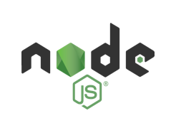





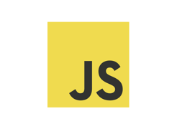
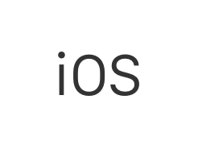
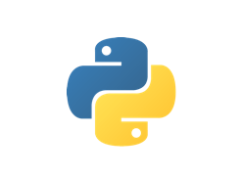
LaunchDarkly
https://launchdarkly.com
Feature flags as a service
Serves over 200 billion feature flags/day
Notes:
LaunchDarkly is what I refer to as Feature Flags as a Service. It supports multiple languages, and provides a lot of options for both developers and operations. It uses a streaming architecture to service feature flags in microseconds without making remote requests. All flags are served locally and backed up using a globally distributed CDN provider. They use what’s called Server-Sent Events (SSE), a protocol for one-way real-time messaging, to send messages to your servers whenever you change feature flag rules in your LaunchDarkly dashboard. The SSE connection is handled automatically by the SDK.
It is also pretty easy to get started with, with some very nice tutorials that get you up and going in minutes.
Some numbers for you:
200+ Billion Feature Flags served daily
1M+ mobile devices and browsers served daily
340K servers reached world-wide daily
**CLICK**

Slide 25
DEMO: LaunchDarkly Feature Flag as a Service using Azure Devops
Notes:
In this final demo, I’m going to show you how to integrate LaunchDarkly’s feature flag service into your application, including your build/release pipelines with Azure DevOps
****************************************************************
For THAT CONFERENCE, we will have everything pre-built, and just walk through it. I should also do the deployment before the talk starts.
Code Location: c:\repos\THAT Conference\LaunchDarkly
Demo Instructions
(This demo is based off the https://www.azuredevopslabs.com/labs/vstsextend/launchdarkly/ HOL)
https://docs.launchdarkly.com/docs/visual-studio-team-services-extension
Azure DevOps Team Project being used is devopsmickey/LaunchDarklyHOL
LaunchDarkly is a continuous delivery platform that provides feature flags as a service and can manage your feature flags at scale. You can make use of its integration with Azure DevOps to tie feature flag rollouts to work items, as well as manage feature flags as part of a release pipeline.
In this demo we are going to:
Implement a LaunchDarkly Feature Flag in an MVC Application
Integrate Launch Darkly with Azure DevOps
Rollout LaunchDarkly Feature Flag as part of an Azure Pipelines release
STEP 1: Create a Feature Flag in LaunchDarkly
Log into LaunchDarkly
Create a new feature flag: “Member Portal”
Get the Production SDK Key
STEP 2: Add Feature Flag to Web Application
Turn on Work Item Management in Team Project settings under repository
Clone the repo in Visual Studio
Check out the launch-darkly branch and open the PartsUnlimited.sln
Install the LaunchDarkly NuGet Package
Restore all packages and build the app (dotnet restore)
Run the app and you should see the Member Portal in top right
Replace code in HomeController with snippet from HOL. This adds the LDClient object and adds the if statement that uses the launch darkly feature flag. Do the same with AccountController
Modify Views\Shared\_Layout.chtml, line 55 with @if (ViewBag.togglevalue == true) { @await Html.PartialAsync("_Login") }
Add LaunchDarkly SDK key to HomeController and AccountController
HomeController starts with initializing a static LaunchDarkly client. And the methods to view MemberPOrtal are modified to check the feature flag is on or off. The _Layout.cshrml page checks the toggle value and renders the link if it is turned on.
When you request a feature flag, you need to pass in a user object. So we are initializing the user object in the begtinning. This will be used to check whether a user with a specified key exists in launchdarkly or not. In real time it might be from a logged in user, or a database, for example.
We then call BoolVariation to check the value. If it is true, we set a view data value to its value.
Run the application. Turn the flag on manually and run again. Turn the flag off.
In team explorer, navigate to changes and commit/push the code, associating it with the work item
Open the work item and you can see the commit associated with it.
STEP 3: AUTOMATICALLY Rollout LaunchDarkly feature flags during release
First, we need a launchdarkly access token to integrate with Azure DevOps.
Azure DevOps | Project Settings | Pipelines | Service Connections | New LaunchDarkly Service Connection and create a new service connection
Open work item and view Launch Darkly tab, select the feature flag
Configure the release pipeline
Execute the build and it should also release and enable the flag

Slide 26
Be Careful With Feature Flags
Notes:
Ahhhh, but, as wonderful as feature flags are, you do have to be careful with them
**CLICK**

Slide 27
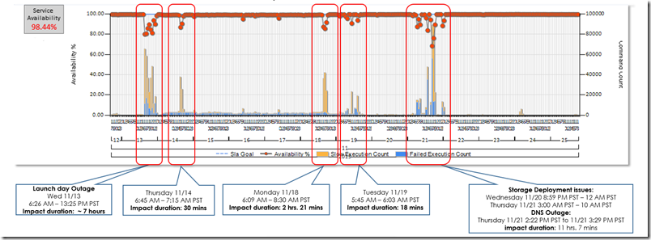
That’s great…what could go wrong?
Features to be revealed at Connect 2013 event
We turned features on globally (SU1) just before the keynote...
It didn’t go well.
Notes:
https://blogs.msdn.microsoft.com/bharry/2013/11/25/a-rough-patch/
Seriously, what could go wrong with Feature Flags?
**CLICK**
Well, in 2013, we had this new service called Visual Studio Online (aka VSTS, AKA Azure DevOps) that we wanted to show a bunch of new feature work off at.
**CLICK**
We had all the new features hidden behind feature flags. Right before the keynote, we turned on ALL the features
**CLICK**
And things did not go well. We brought the service down for 8 hours, and it took almost a week to get the service stable again.
**CLICK**

Slide 28
What went wrong?
Turned on flags in production morning of event
On the only instance we had at the time
Now…
Incrementally turned on
Turned on completely at least 24 hours ahead of an event
Notes:
We only had TFS SU1 and SPS at the time
https://blogs.msdn.microsoft.com/bharry/2013/11/25/a-rough-patch/
What went wrong?
**CLICK**
We turned on all the flags the morning of the event, on the only instance we had of the service at the time. And while we had done testing, we had not predicted the interactions that would happen when turning on all the features at one.
**CLICK**
Now
**CLICK**
We turn on new features via feature flags incrementally. And we always make sure any new features are turned on completely at least 24 hours ahead of an event.

Slide 29
Feature Flags == Technical Debt
Feature flags are technical debt as soon as you add them to your system
Review flags often
Be diligent about removing old flags and their supporting infrastructure
Notes:
Something else to remember is that feature flags are technical debt. They are new code you are adding to your system. If you decide to use feature flags, you need to have a system in place where you review all the feature flags currently in your environment.
You need to also be very diligent about removing old flags and their supporting infrastructure. Once a feature has been “turned on permanently” for everyone, you don’t need that feature flag anymore, and you don’t need the old infrastructure code anymore. Make sure to clean up after yourself. Otherwise, supporting your code base will slowly turn into a nightmare.

Slide 30
Conclusion
DevOps is awesome
Feature flags are awesome
Multiple feature flag frameworks (free and consumer)
Nobody rides for free
“With great power comes great responsibility”
Notes:
So we’ve talked about a lot of things during this session. Let’s see if we can wrap it up succinctly.
**CLICK**
Devops is awesome
**CLICK**
Feature Flags are awesome
**CLICK**
There are multiple feature flag frameworks available to help you get started, both free and consumer
**CLICK**
Remember, no one rides for free. Feature flags are technical debt, and need to be watched carefully. In the words of Uncle Ben, “With great power comes great responsibility:

Slide 31
Resources
http://github.com/jason-Roberts/FeatureToggle
https://github.com/launchdarkly/featureflags
http://featureflags.io/
https://launchdarkly.com/
https://docs.microsoft.com/en-us/azure/azure-app-configuration/
https://devblogs.microsoft.com/devops/effective-patterns-for-feature-flags/
https://www.azuredevopslabs.com/labs/vstsextend/launchdarkly/

Slide 32











DevOps CAT team mission
Work with Microsoft’s largest customers to help them accelerate their DevOps transformation.

Slide 33

Me
Mickey Gousset
Joined Microsoft June-18
Dev Tools MVP - 14 years
Tupelo, Mississippi, USA
@mickey_gousset
mickeygousset.com
mickey.gousset@microsoft.com

Slide 34
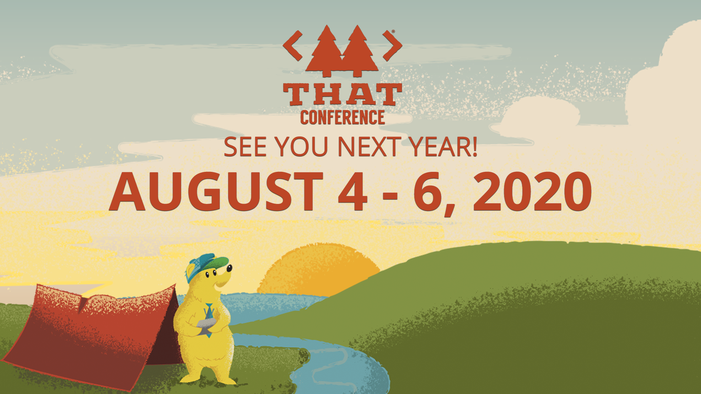
Mickey Gousset
@mickey_gousset

